Slide 1
BRAINWARE UNIVERSITY AI-Powered Personalized Tutor System
NAME:- ANUSKA DUTTA
BRANCH :- CSE(AI-ML)
SEMESTER/YEAR :- 6TH/ 3RD

Slide 2
Introduction:-
The AI Tutor Project was developed to provide a personalized, AI-powered tutoring system that enhances learning experiences across multiple subjects. The goal was to create an accessible, offline-capable, and cost-effective educational tool that does not rely on constant internet connectivity or paid subscriptions.
By leveraging artificial intelligence, the system can understand user queries , provide relevant answers, track progress, and offer adaptive learning experiences. The development journey involved multiple iterations of AI models, dataset improvements, UI enhancements, and deployment optimizations to ensure a seamless and effective user experience.
This report outlines the architecture, AI model evolution, UI development, key challenges, solutions, and future enhancements that contribute to the success and scalability of the AI Tutor system.

Slide 3
Project Overview:-
Key Features:
Offline Accessibility – Works without internet, making it ideal for students in low-connectivity areas.
No Subscription Fees – Unlike many tutoring apps, AI Tutor is free and accessible to all.
Personalized Learning – Uses subject-specific AI models to tailor responses based on learning levels.
Advanced Question Handling – Special processing for arithmetic calculations, subject-specific terminology, and fallback mechanisms for more accurate answers.
Optimized Performance – Lightweight and fast, with caching mechanisms to reduce lag and improve response speed.
Structured Progress Tracking – Helps users monitor their learning progress and improve systematically.
Modular & Expandable Design – Supports future enhancements like transformer-based AI, multimedia content, and multi-language support.
Tech Stack:
Frontend & Backend: Streamlit
AI Model: Scikit-learn (TF-IDF + Random Forest classifier)
Styling: Tailwind CSS
Storage: Local file system

Slide 4
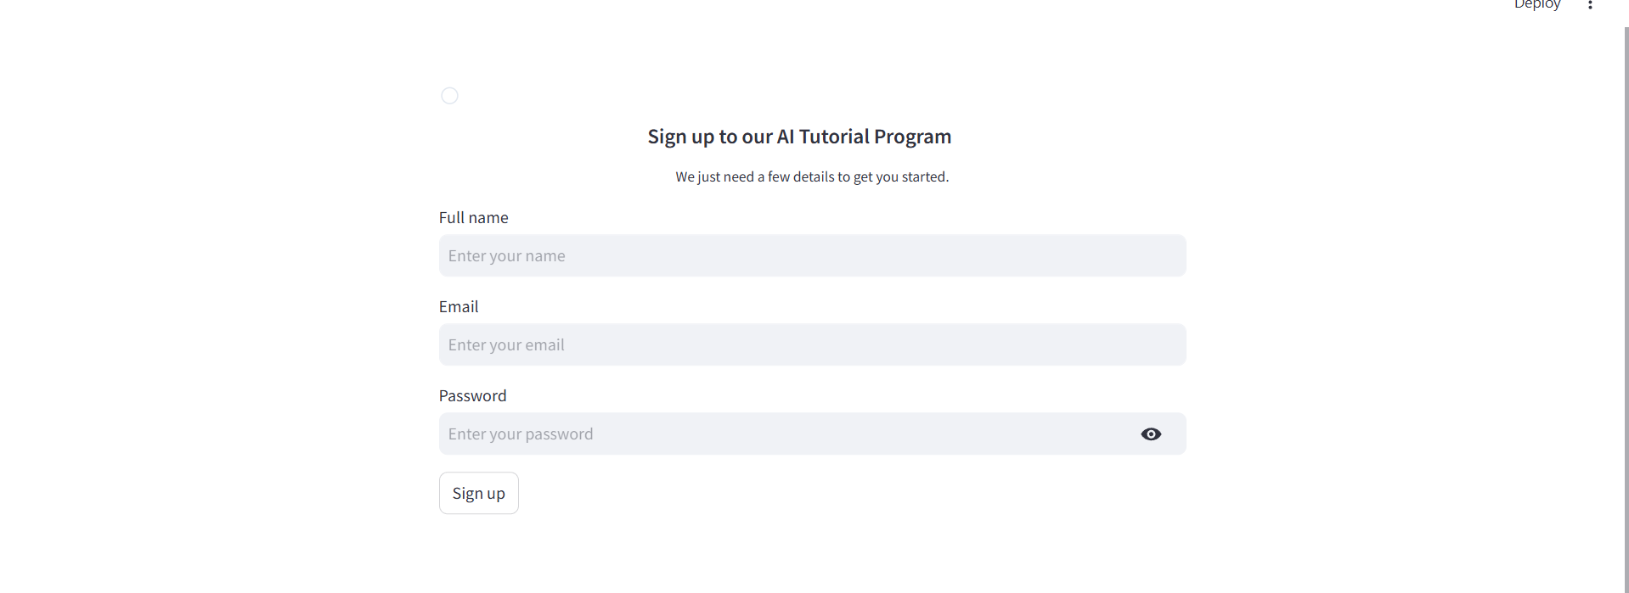
Development Journey:-
AI Model Evolution
V1: Basic keyword matching with minimal dataset
V2: TF-IDF vectorization with cosine similarity
V3: Subject-specific models
V4: Enhanced comprehensive datasets
V5: Specialized handling (e.g., arithmetic calculations)
Data Collection
Subject-specific datasets with Q&A pairs
Specialized scripts for dataset creation
Special handling for mathematical operations

Slide 5
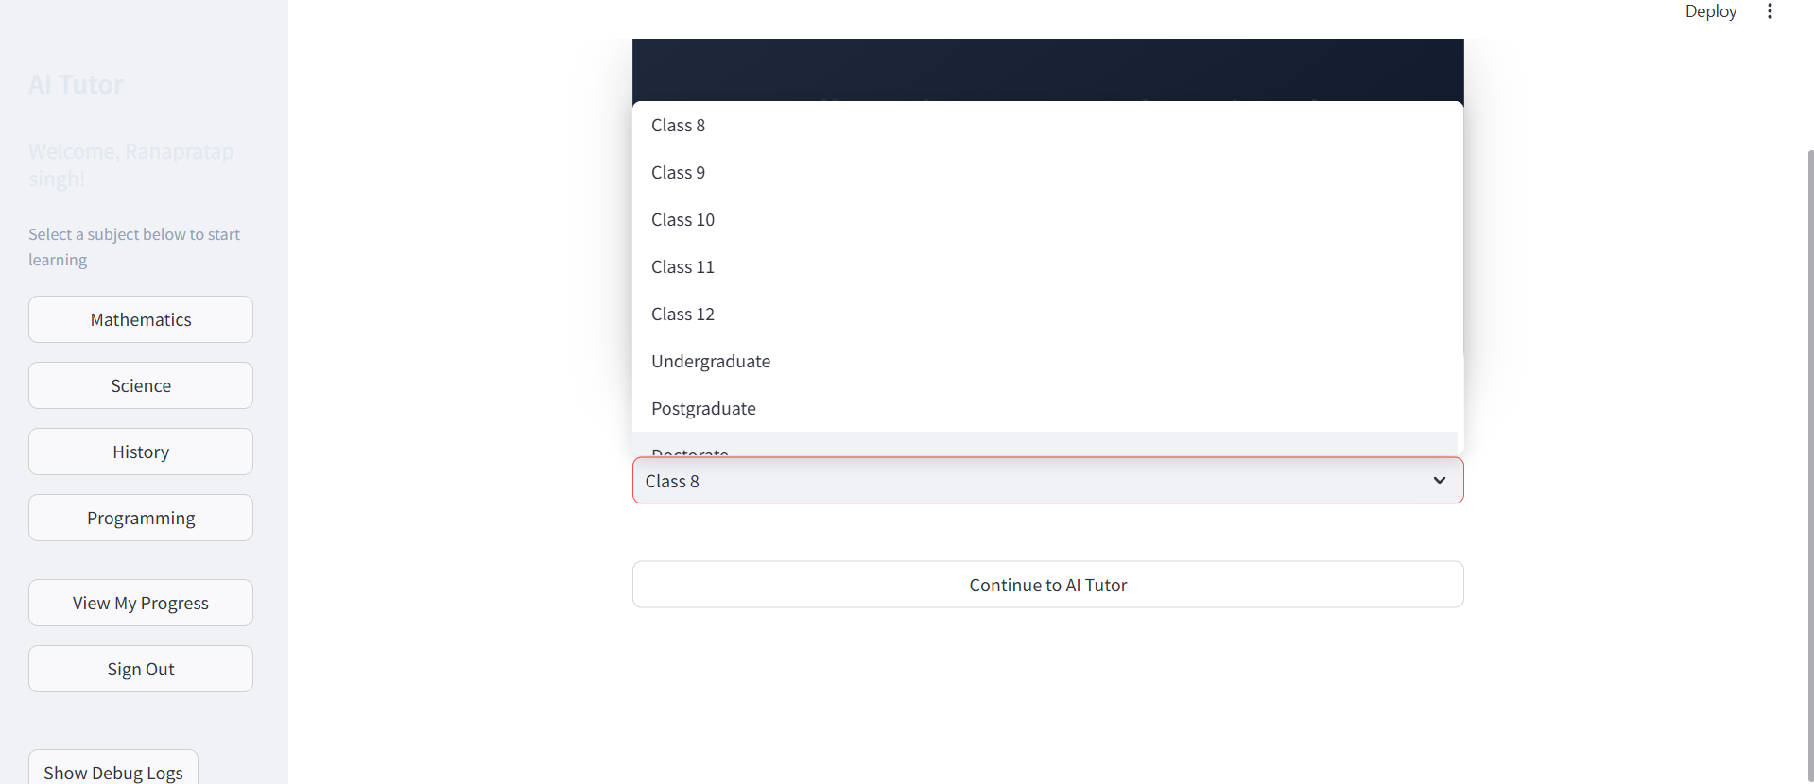
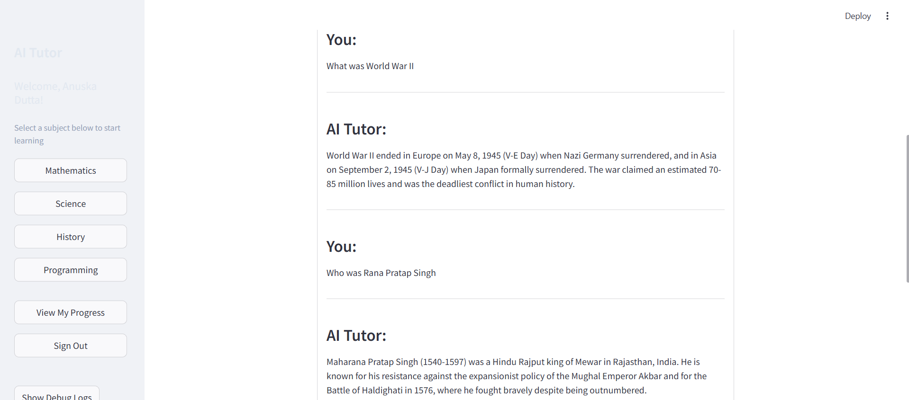
Key Implementation Feature:-
User Interface
Modern, intuitive design with Tailwind CSS
Subject selection cards with visual indicators
Chat-like Q&A interface
Progress visualization
Special Case Handling
Arithmetic operations parser
Subject-specific terminology recognition
Contextual fallback responses
Deployment Solution
Comprehensive requirements.txt
All-in-one batch file (ai_tutor.bat)
Organized directory structure

Slide 6
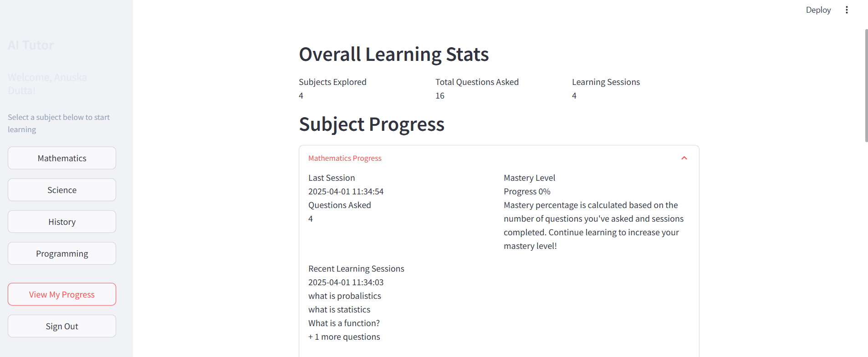
Challenges & Solutions
Challenge | Solution
Model accuracy | Subject-specific datasets & improved matching algorithms
Performance issues | Optimized loading & caching mechanisms
User experience | Clearer navigation & responsive design
Mathematical questions | Dedicated arithmetic handler
Limited datasets | Comprehensive dataset generators

Slide 7
Future Directions
Integration pf transformer-based AI model
Expansion to specialized topics
Multimedia content support
Proper database implementation
Analytics dashboard
Multi-language supporter

Slide 8
Conclusion:-
The AI Tutor Project is a smart, adaptive, and accessible learning solution designed to provide personalized education without requiring subscriptions or internet access. By leveraging subject-specific AI models, it delivers accurate and context-aware responses, enhancing the overall learning experience.
Its intuitive interface ensures ease of use, while progress tracking helps students monitor their learning journey. Optimized for efficiency, AI Tutor provides fast response times with minimal resource consumption.
Built for scalability, the system allows for future enhancements, including advanced AI models, multimedia content, and multilingual support. By combining AI-driven learning with accessibility and efficiency, AI Tutor bridges educational gaps, making quality education available to a wider audience.

